Slide 1


http://studyjams.scholastic.com/studyjams/jams/science/matter/changes-of-matter.htm
video

Slide 2

Physical Changes
a change that occurs
without changing the identity of the substance.
No new substances are formed.

Slide 3

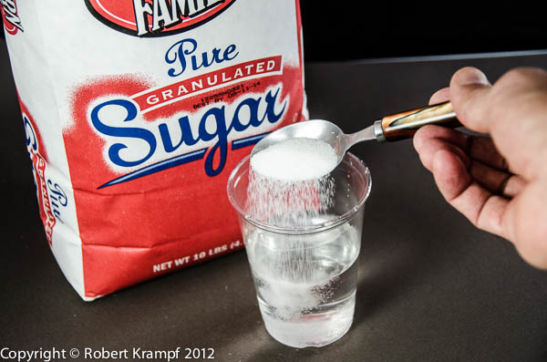
Examples of Physical Changes
Change in size or shape
  Pencil shavings
  Torn Paper
  Crushed ice
Dissolving
  Sugar dissolved in water
State Change
  Freezing, evaporating, boiling, etc

Slide 4

Chemical Changes
a change that occurs that causes the identity of a substance to change
New substances with new properties are formed

Slide 5
Evidence of Chemical Change
Precipitate forms
(solid material)
Odor is produced
New color appears
Bubbles or fizzing

Slide 6
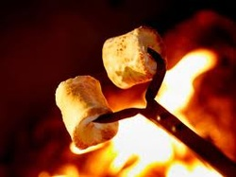
More evidence…
Energy is produced
  Light
  Heat
  Sound
Difficult or impossible to reverse

Slide 7
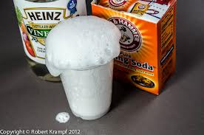
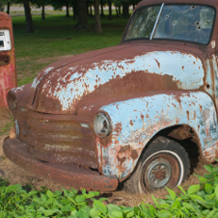
Examples of Chemical Changes
Reactions with Acids
  Vinegar + baking soda =
release of Carbon Dioxide Gas
Reactions with Oxygen
  Iron + oxygen = rust

Slide 8
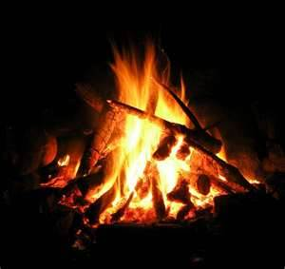
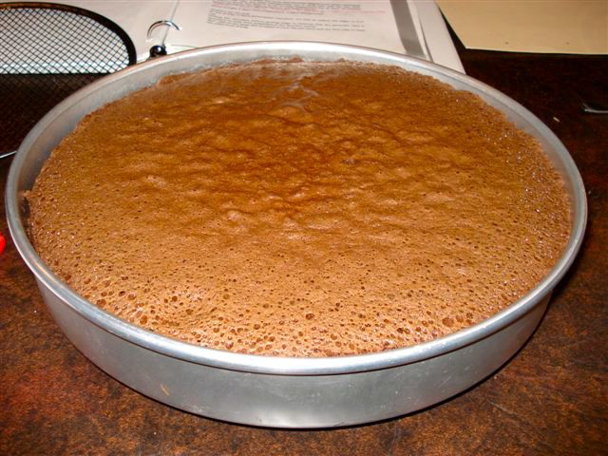
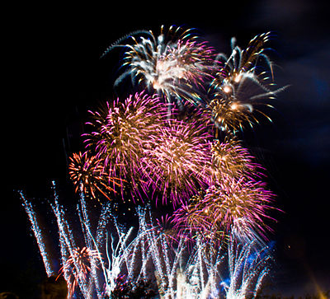

More Examples
Wood burning
Leaves changing
Food digesting
Fireworks
Cooking/baking

Slide 9
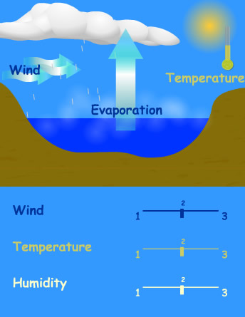
Physical or Chemical Change?
Water evaporates from the ocean.

Slide 10

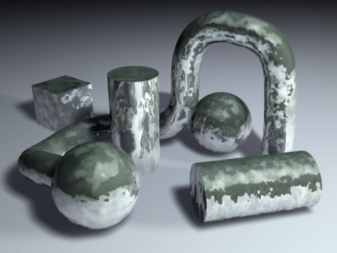
Physical or Chemical Change?
The yolk of an egg, which contains sulfur, causes tarnish to form on silver.

Slide 11

Physical or Chemical Change?
The ice on a lake melts to become water in the lake.

Slide 12
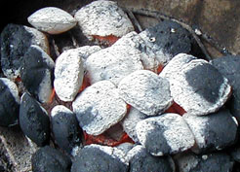
Physical or Chemical Change?
Charcoal in a fire turns to ash after several hours.

Slide 13

Physical or Chemical Change?
A battery makes electricity to turn on a flashlight.

Slide 14
Physical or Chemical Change?
A pencil is sharpened in a pencil sharpener, leaving behind shavings.

Slide 15
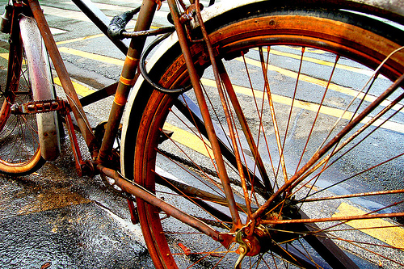
Physical or Chemical Change?
A bicycle rusts when left in the rain.

Slide 16

Physical or Chemical Change?
A shirt is accidentally torn in the washing machine.

Slide 17

Physical or Chemical Change?
A log is split in two by an axe.

Slide 18
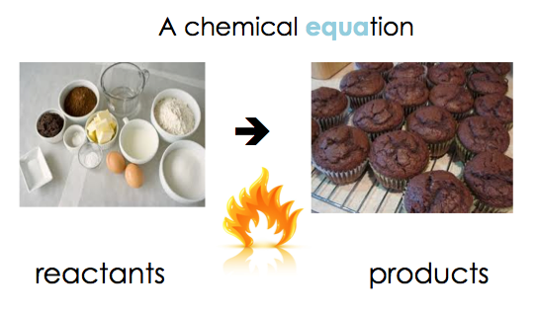
Reactants and Products
Reactants:
  what reacts to form a chemical reaction
  starting point in a change
Products
  what is produced in a chemical reaction
  results of the change

Slide 19
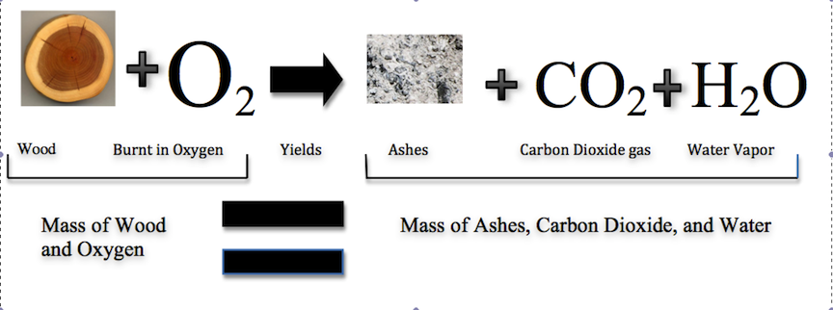
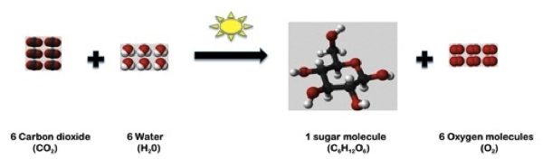
Molecules of the reactants rearrange to become molecules of the product.
Reactants Products

Slide 20
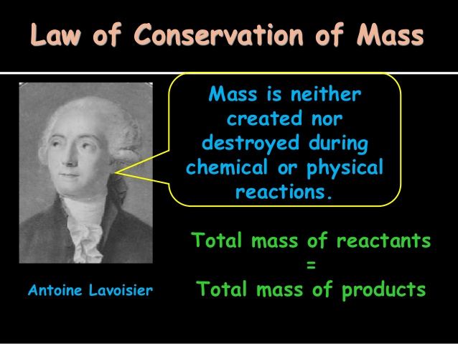

Slide 21
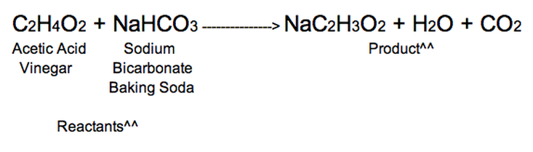
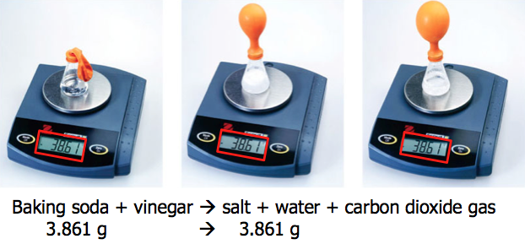
Same elements but new molecules are formed.

Slide 22
