Slide 1
Cellular Transport
Processes in which nutrients pass through a cell membrane
Cellular Transport video

Slide 2
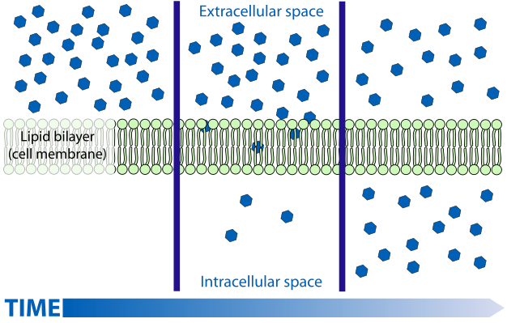
diffusion
Moves substances from areas of high concentration to areas of lower concentration
Passive transport: requires no energy
Continues until equilibrium is reached
Example: perfume in air or food coloring in water

Slide 3
Osmosis
Passive transport
Diffusion of water across a membrane
Cells are surrounded by water creating equilibrium. If they weren’t, osmosis would move water out
Example: water/iodine passing through baggie and turning starch purple

Slide 4
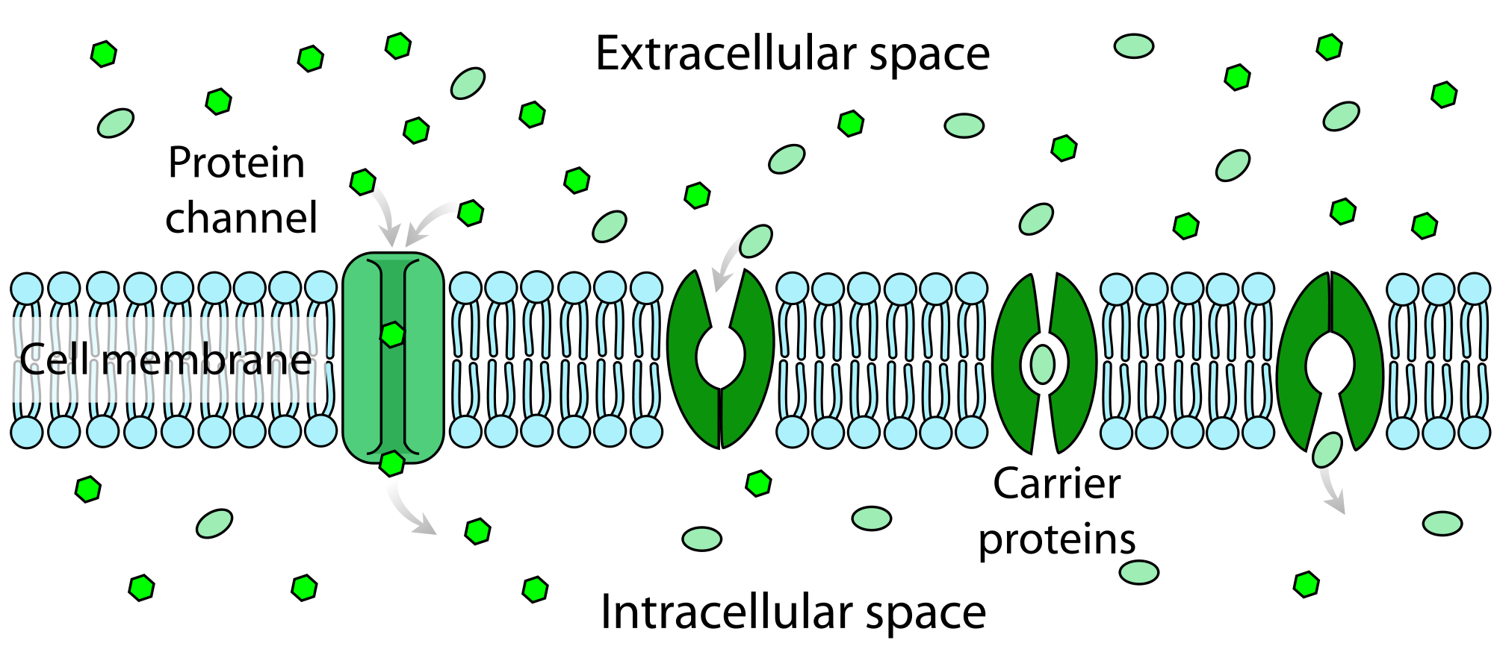
Facilitated Diffusion
Passive transport
Allows larger substances to enter cell with help of transport proteins
Like a drive thru window

Slide 5
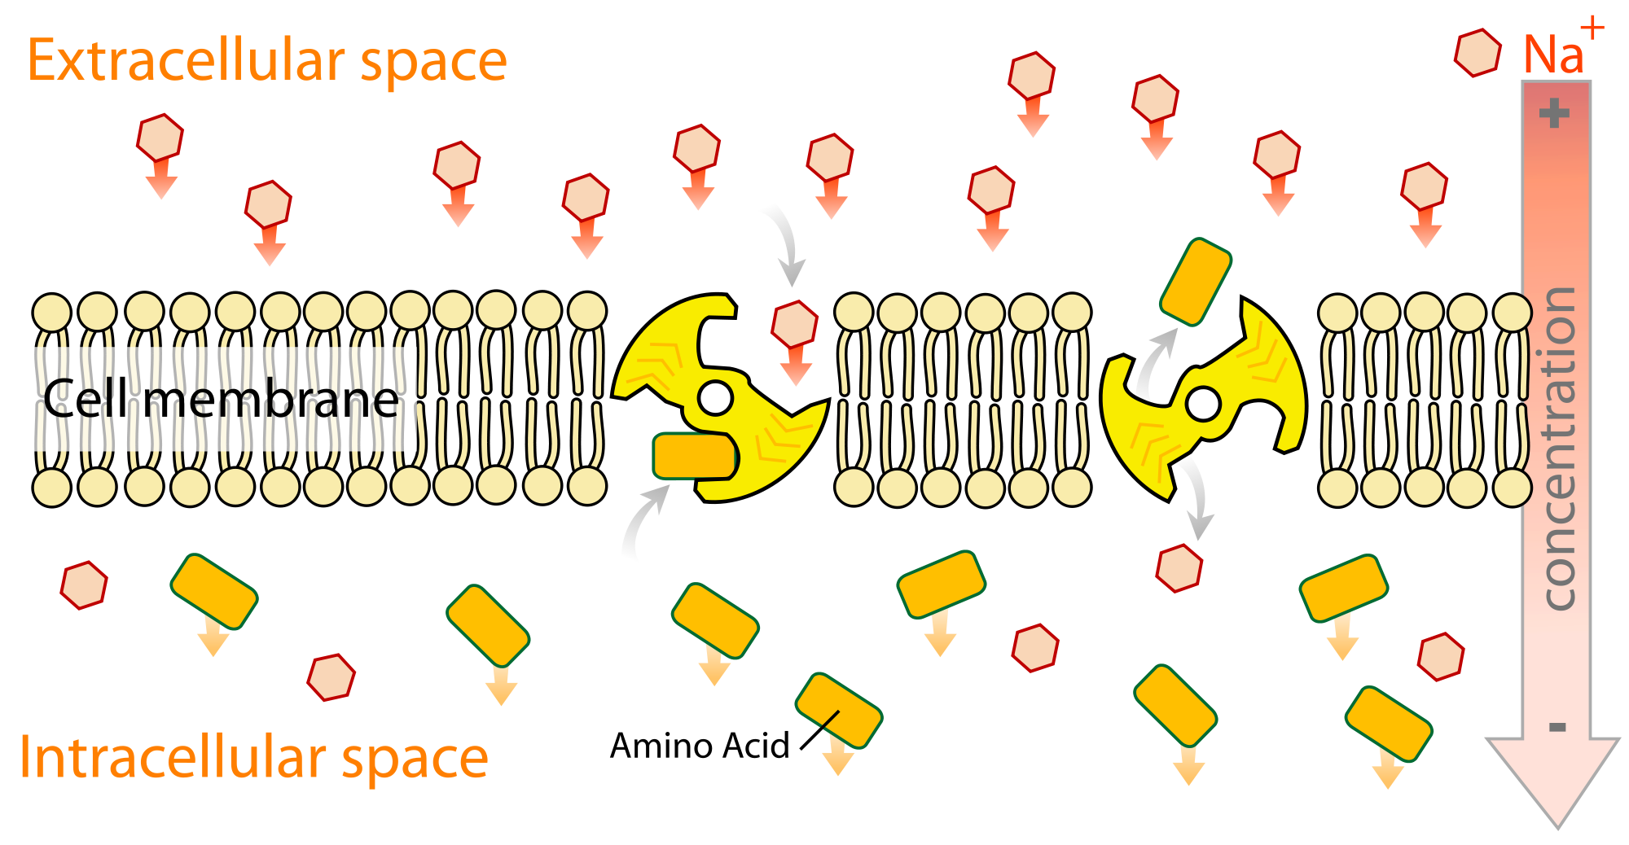
Active Transport
Require ENERGY to move nutrients into cell
Concentration of substance is already greater inside the cell
Like moving into a football stadium as the crowd is leaving

Slide 6
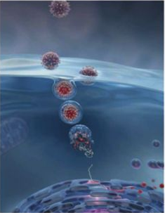
Moving Large particles
Endocytosis:
The cell membrane takes particles into the cell by changing shape and engulfing the particles
Happens when particles are too large to cross the cell membrane

Slide 7
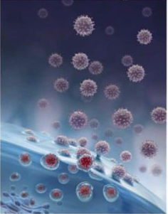
Moving large particles
Exocytosis
Allows large particles to leave the cell
The vacuole surrounding the food particles fuses with the cell membrane, forcing the contents out of the cell

Slide 8
Cells need nutrients. They provide energy and materials needed to build cell structures

